Slide 1


EMPLOYEE
ASSISTANCE PROGRAM
EAP OVERVIEW
MORE THAN A BENEFIT
Well-Being. Done Well.

Slide 2






SERVICES AVAILABLE
LEGAL/FINANCIAL RESOURCE &
REFERRAL
PERSONAL ASSISTANT
CONFIDENTIAL SUPPORT
ENHANCED WORK/LIFE WEB TOOLS
LIFE COACHING
MEDICAL ADVOCACY
WELL BEING, DONE WELL

Slide 3




BACKING THE BADGE
BTB is a division of Encompass EAP, a proud member of the AllOne Health Family of EAPs Designed to meet the unique needs & stressors placed on first responders and their loved ones All services are confidential
What Does The Team Offer?
Professionals who are experienced in addressing challenges related to these fields, either with experience as first responders themselves or who have exclusive knowledge of the unique culture
Clinicians have continuing education in fields, like trauma, PTSD, marital counseling, and much more.

Slide 4



MENTAL HEALTH COUNSELING
Available to employees and household family members
Licensed Master's level counselors Accessible via phone, mobile app, chat, and video 24/7
Free short-term counseling
For Help With:
Family Conflict Couples/Relationships Substance Abuse Work/Life Balance Stress
Depression Grief Anxiety Parenting

Slide 5



LIFE COACHING
Available to employees and household family members
Free telephonic or video sessions Supporting your personal and professional goals
For Help With: Life Transitions
Enhancing Communication Skills Improving Stress and Time Management Creating Better Work/Life Balance Managing Multiple Projects and Demands Living a More Purposeful Life
Setting Goals and Action Steps Improving Relationships

Slide 6



LEGAL & FINANCIAL RESOURCES
Legal Assistance Financial Assistance
Bankruptcy Divorce/Custody Estate Planning/Wills Real Estate
Adoption Elder Care
Bankruptcy Home Buying Debt
Identity Theft Retirement Planning
College Planning Funding
Our legal assistance connects individuals with a qualified attorney for a FREE 30-minute consultation. The financial assistance connects individuals with certified financial planners, certified public accountants and credit counselors based on their needs.

Slide 7



PERSONAL ASSISTANT
Helping manage every day tasks on your 'to do' list
Services Include:
Travel
Sports and Recreation Household Errands Professional Services Entertainment Planning Housing and Real Estate Cleaning Services
Home Food Delivery
Access a Personal Assistant via: phone, web portal, mobile app, and chat.

Slide 8



MEDICAL
ADVOCACY
AllOne Health Medical Advocates lend a hand with all aspects of health care. It can be difficult to understand and navigate the systems and choices before you. Our advocates can help you interpret medical information related to claims, coverage and medical diagnosis. Our comprehensive approach gives you the support you need to make important decisions about taking care of yourself and your loved ones. You don’t have to be alone to manage the complexity of health care.
For Help With: Insurance Navigation Doctor Referrals
Health Care Transportation Durable Medical Equipment Discharge Planning
Care Transition Geriatric Care
Advocacy and Research Medical Appointment Preparation

Slide 9



WORK/LIFE RESOURCES
Navigating the practical challenges of
life, while handling the demands of your job can be stressful. AllOne Health Work/Life resources and referral services are designed to provide knowledgeable consultation and customized guidance to assist with gaining resolution to everyday hurdles.
For Help With:
Childcare Eldercare Housing Transportation Adoption
Education Wellness Pet Care
Special Needs Support

Slide 10

Expanded Access
REDEFINING THE CLASSIC EAP
Our Total Well-Being model offers everyday solutions for you and your family. Our goal is to create meaningful connections through our broad range of services and multiple access points.
TO SCHEDULE A CONFIDENTIAL APPOINTMENT:
Contact us at (844) 871-3577 or visit us at www.encompass.us.com
WELL BEING, DONE WELL

Slide 11
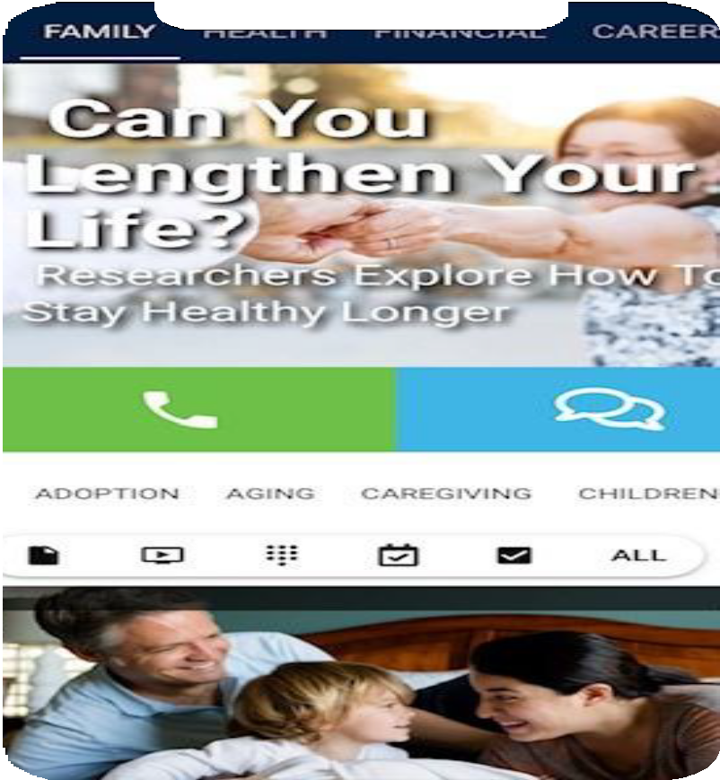

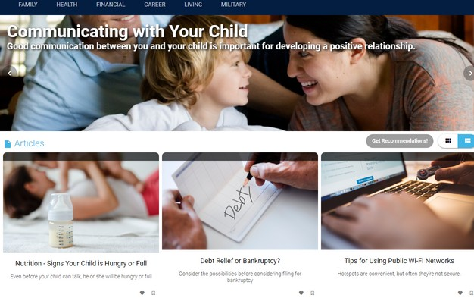
Website & Member Portal
Our brand new, game-changing mobile app and website allows users to have all the tools necessary for a healthy work/life balance, at their fingertips!
MY LIFE EXPERT ALLOWS YOU ACCESS TO:
ACCESS YOUR FULL EAP BY CALLING:
844-871-3577
THOUSANDS of articles, videos, and worksheets
Quick Health and Lifestyle assessments and surveys
Interactive checklists
Events Calendar for the latest webinars and online training sessions
Your company's HR info and company-wide alerts
Build your own Employee Profile 24/7 instant, confidential support
DOWNLOAD THE APP BY VISITING:
www.encompass.us.com
OR
SIMPLY SCAN THIS QR CODE
TO LOG IN, USE COMPANY CODE:
gtmetro

Slide 12



ORGANIZATIONAL DEVELOPMENT
SERVICES
Promoting the Well-Being of your Organization:
On-site Training Webinar Training Mediation
Team Building Executive Coaching
OUR MOST POPULAR TRAININGS:
Promoting a Respectful Workplace
Management 101
Effective Communication Strategies

Slide 13



WORKPLACE TRAUMA RESPONSE
ASSISTANCE CAN BE PROVIDED FOR SITUATIONS SUCH AS:
Employee Illness or Death Layoffs
Natural Disasters
Other Events that Destabilize the Workforce
Your response to a workplace crisis can mean the difference between employees returning to previous levels of performance quickly or prolonged impairment. Training for HR and other personnel about critical incident stress can help you prepare for such occurrences and put appropriate protocols in place.

Slide 14
CONTACT US TO SCHEDULE A
CONFIDENTIAL APPOITMENT:
844-871-3577
www.encompass.us.com
Company Code: gtmetro

